Slide 1
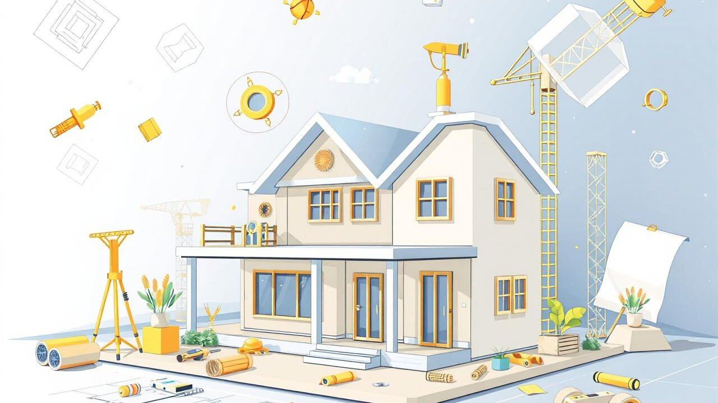
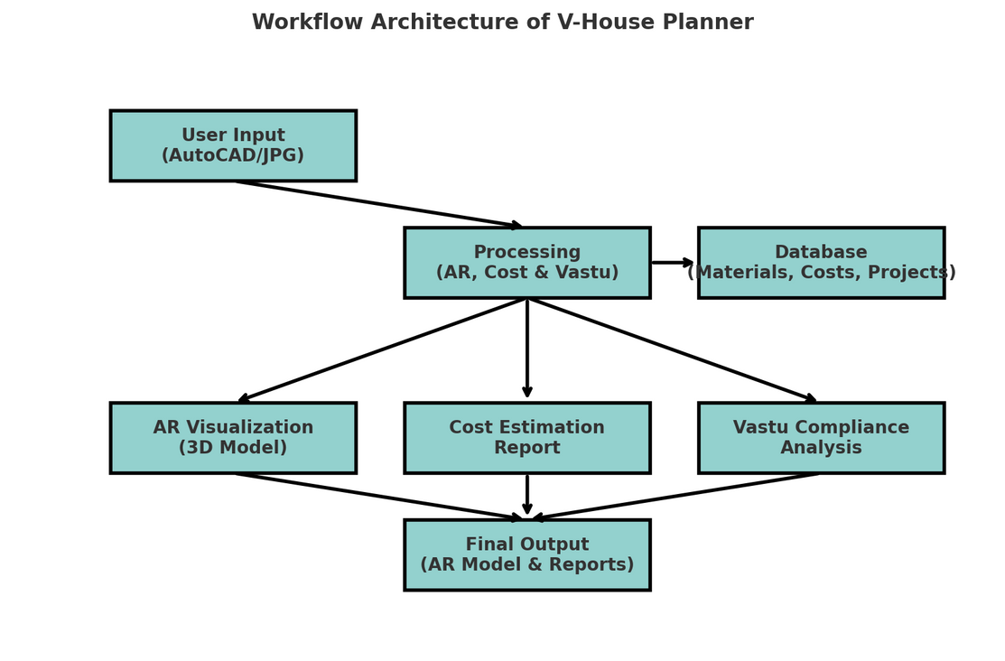
V-House Planner
AR-Based Construction Planning & Vastu Compliance
Objective :
Develop an AR-based mobile application to provide real-time 3D visualization of house designs, ensuring accurate cost estimation and Vastu compliance before construction. The app allows users to upload AutoCAD/JPG files, interact with AR-generated models, and receive dynamic cost updates for better financial planning.
Unique Features :
Augmented Reality (AR) Visualization – Provides real-time 3D house models for interactive exploration.
Live Cost Estimation – Auto-updates construction costs based on material selections and market price fluctuations.
Vastu Compliance Checker – Analyzes floor plans and suggests modifications for Vastu alignment.
User-Friendly Interface – Simple, intuitive UI for homeowners, architects, and builders.
Cloud Integration – Saves multiple project versions, allowing collaboration and accessibility across devices.

Slide 2


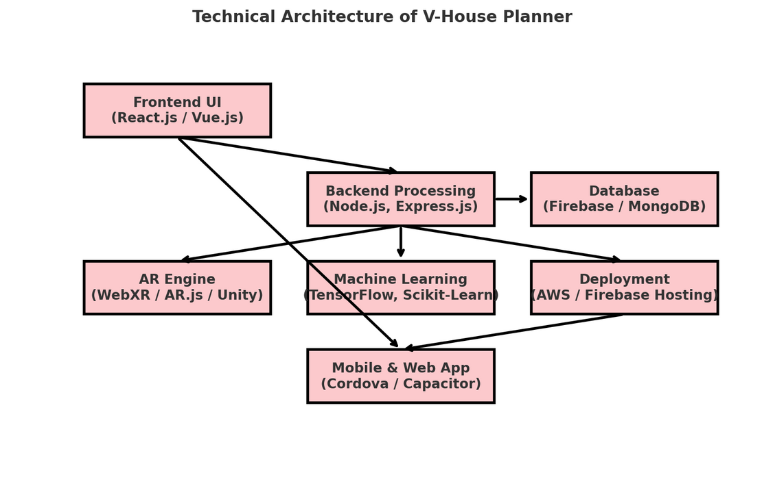
V-House Planner
AR-Based Construction Planning & Vastu Compliance
ASIET
Shoun Augustine, Sam Davis Martin, V Harihara Iyer, Mariya Shaju
Advisor : Dr. Ramani Bai V, CSE
Abstract :
Traditional construction planning often leads to miscommunication and design errors due to reliance on 2D blueprints and brochures. Additionally, cost estimation inaccuracies and lack of Vastu integration affect project planning. This project proposes an AR-based interactive system that enables users to visualize house designs in real-time, analyze cost estimates dynamically, and ensure Vastu compliance. The system processes uploaded designs, renders an interactive AR model, and provides live cost updates, improving clarity in decision-making.
Working in Brief :
The user uploads an AutoCAD or JPG file of their house design. The system processes the file and generates a real-time 3D model using AR technology. Users can visualize the structure, make modifications, and check for Vastu compliance. The cost estimation module provides auto-updated budget calculations based on selected materials and live price trends. The final output includes an interactive AR house model, Vastu report, and a detailed cost breakdown for informed decision-making.
Conclusion / Recommendations :
Provides a more accurate and immersive experience in construction planning.
Eliminates design errors and cost miscalculations, improving project efficiency.
Ensures better financial planning through real-time budget updates.
Integrates traditional Vastu principles with modern AR technology, making it more relevant for Indian users.
Existing System :
Construction planning depends on 2D designs and verbal communication, leading to misunderstandings.
Cost estimation relies on manual calculations, which can be inaccurate and outdated.
Vastu compliance is checked manually, with no real-time validation tools available.
Proposed System :
An AR-based interactive visualization system for real-time house model exploration.
Live cost estimation module with automatic updates based on market fluctuations.
Vastu compliance checker that analyzes and suggests modifications.
A user-friendly interface for homeowners, architects, and contractors.
Future Scope :
Expand the system to support more regional architectural styles.
Integrate AI-based material recommendations for cost optimization.
Enhance AR features for furniture placement and interior planning.

